Slide 1
Employee Data Analysis using Excel
STUDENT NAME: BHARATH.R
REGISTER NO: 312219248 (asunm1709312219248)
DEPARTMENT: B.COM(General) \ COMMERCE
COLLEGE: LAKSHMI BANGARU ARTS AND SCIENCE COLLEGE
MELMARUVATHUR

Slide 2
PROJECT TITLE
Employee Performance Analysis using Excel

Slide 3

AGENDA
Problem Statement
Project Overview
End Users
Our Solution and Proposition
Dataset Description
Modelling Approach
Results and Discussion
Conclusion
3/21/2024 Annual Review

Slide 4

PEOBLEM STATEMENT
Data Analysis: Utilize Excel functions and tools such as pivot tables, charts, and conditional formatting to analyze the performance data. Develop formulas and models to calculate performance scores and identify trends.
Visualization and Reporting : Create visual dashboards that provide a clear and comprehensive view of employee performance. Generate detailed reports that summarize individual and team performance, highlighting areas of strength and opportunities for improvement.
Decision Support: Provide actionable insights based on the analyzed data to support decision-making processes related to promotions, training, and other HR activities.

Slide 5

PROJECT OVERREVIEW
Project Objective: The primary goal of this project is to develop a comprehensive system to collect, manage, and analyze employee data to enhance performance management, optimize workforce productivity, and inform strategic decision-making.
Scope of the Project:
Data Collection: Gather data on employees from various sources such as HR records, performance reviews, attendance systems, and project management tools.
Data Management: Develop a centralized repository for storing employee data securely and ensuring easy access for authorized personnel.
Performance Analysis: Create metrics and KPIs to measure employee performance, track progress over time, and identify areas for improvement.
Reporting and Visualization: Generate dashboards and reports that provide insights into employee performance trends, high-performing individuals, and departments that may need support.

Slide 6

WHO ARE THE END USERS?
HR Managers and Professionals: They use employee data to manage payroll, benefits, recruitment, onboarding, compliance, and other HR functions. Performance data is used for evaluating employee productivity, conducting performance reviews, and implementing training and development programs.
Team Managers and Supervisors: Managers use this data to understand how their team members are performing, identify high performers and those needing support, and make informed decisions about promotions, rewards, and disciplinary actions.
Employees: Employees themselves may access their own data and performance feedback to understand expectations, track their own progress, set personal goals, and engage in self-improvement.
Finance Departments: They might use employee data for budgeting purposes, payroll processing, and financial planning. Understanding the cost of the workforce and performance ROI is critical for financial forecasting.

Slide 7

OUR SOLUTION AND ITS VALUE PROPOSITION
Data Import and Integration:
Seamless import of employee data from various sources (HR systems, payroll, attendance, etc.).
Integration with existing HR and performance management systems.
Pivot Table Summaries:
Ability to create pivot tables for summarizing employee data across different dimensions such as departments, roles, or time periods.
Easily analyze key performance indicators (KPIs) by aggregating data to find insights.
Graph and Data Visualization:
Dynamic graphing capabilities to visualize trends and patterns in employee performance.

Slide 8
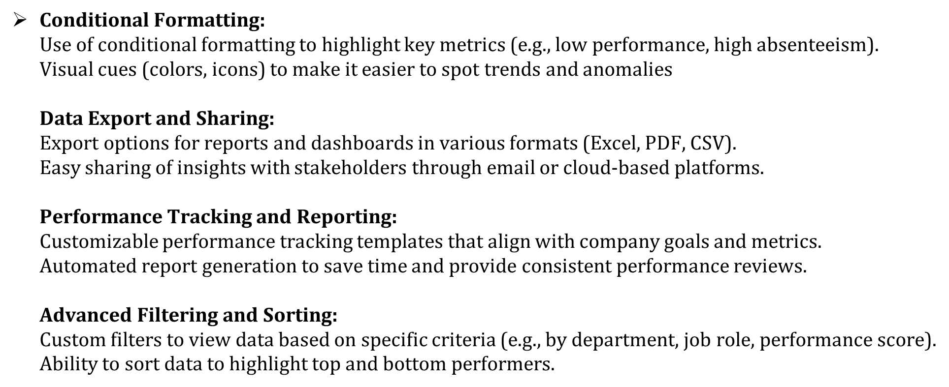
Dataset Description

Slide 9

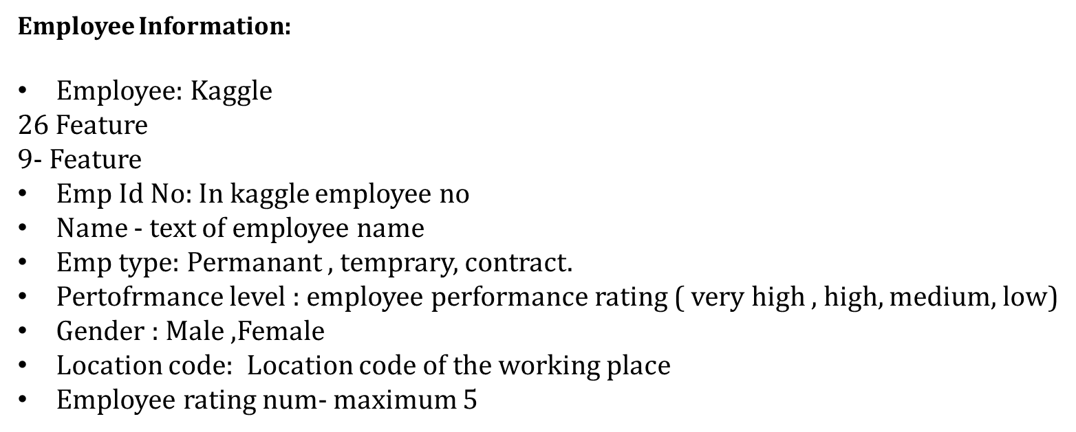
THE "WOW" IN OUR SOLUTION
3/21/2024 Annual Review
9

Slide 10
MODELLING
Intuitive and User-Friendly Interface: Dashboard Design: Use a clean, modern, and intuitive design for dashboards that provide real-time insights. Implement easy-to-navigate interfaces with customizable views so that employees and managers can access relevant data quickly.
Visual Analytics: Include visually appealing charts, graphs, and infographics to make data easy to understand at a glance. Interactive elements like drag-and-drop filters or hover-over details can enhance the user experience.
AI-Powered Insights:
Predictive Analytics: Use AI to predict future trends in employee performance, potential turnover, and other key metrics. This can help in proactive decision-making.
Performance level = IFS(Z8>=5,”VERY HIGH”,Z8>=4,”HIGH”,Z8>=3,”MED”,TURE,”LOW”)
10

Slide 11
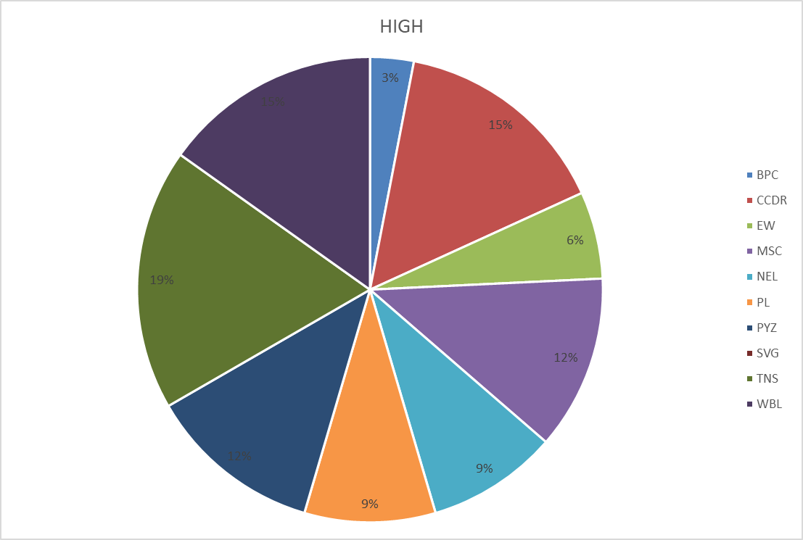
RESULTS
11

Slide 12
conclusion
Visualizing employee data and performance is a critical practice that enables organizations to gain insights into workforce dynamics, identify areas for improvement, and make data-driven decisions. By utilizing various visualization tools and techniques, organizations can transform complex data sets into easily interpretable visual formats, fostering better understanding among managers and decision-makers.
In conclusion, the effective visualization of employee data and performance is an invaluable tool for optimizing workforce management, enhancing productivity, and driving business success.

